Slide 1



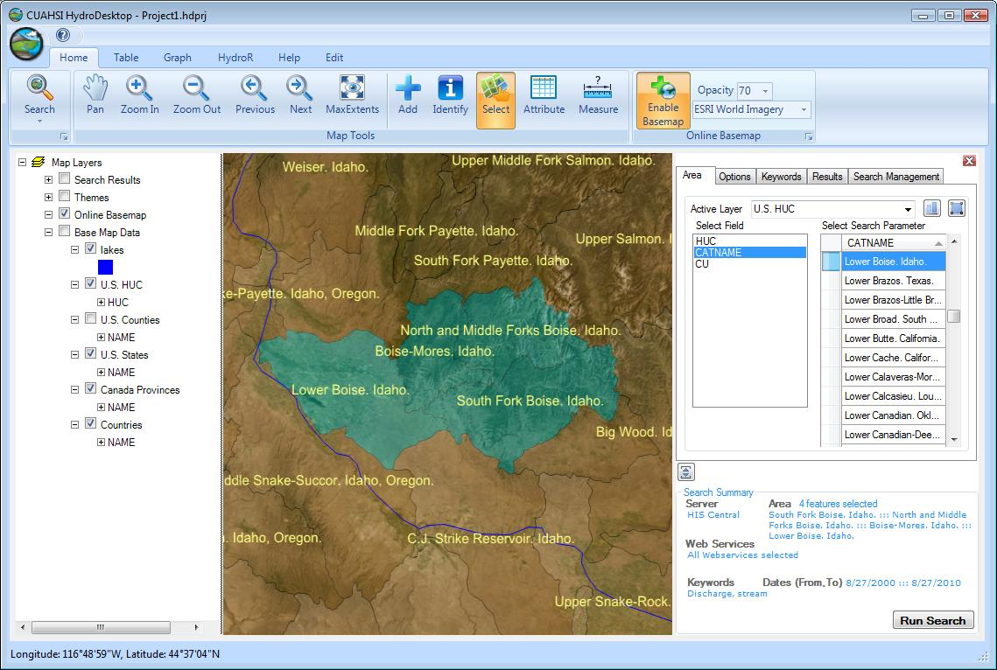
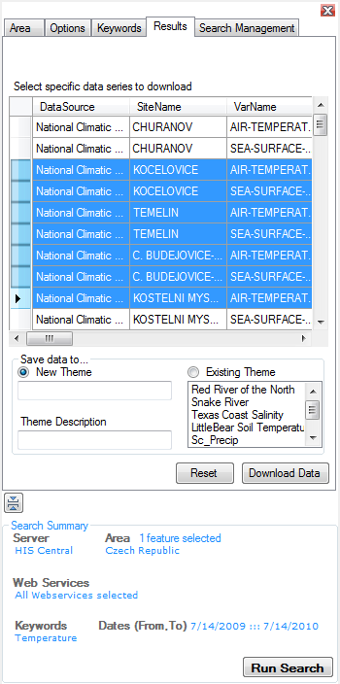
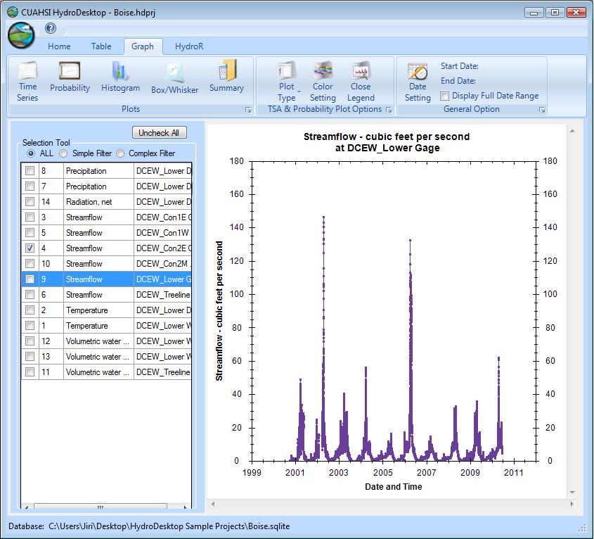
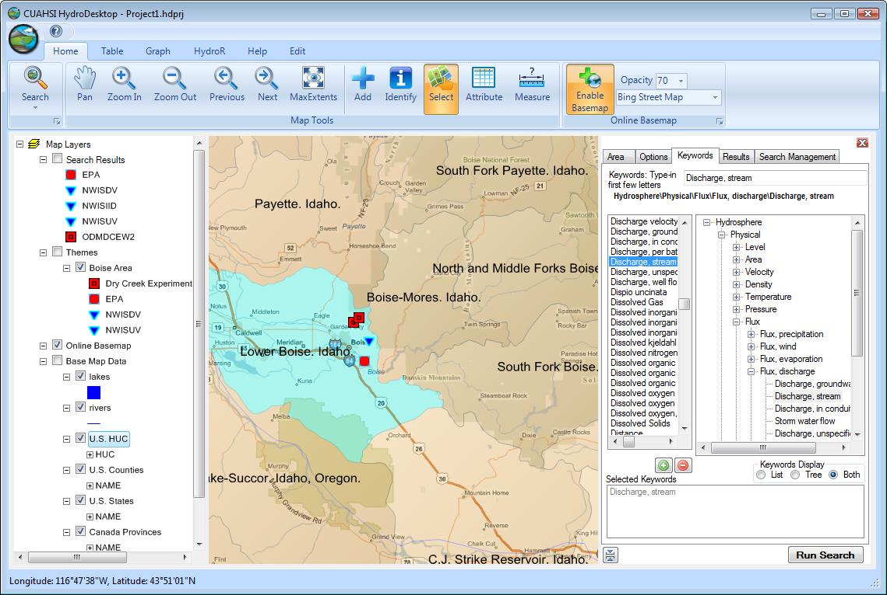
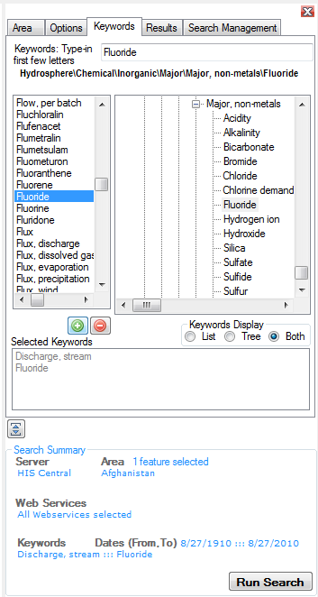
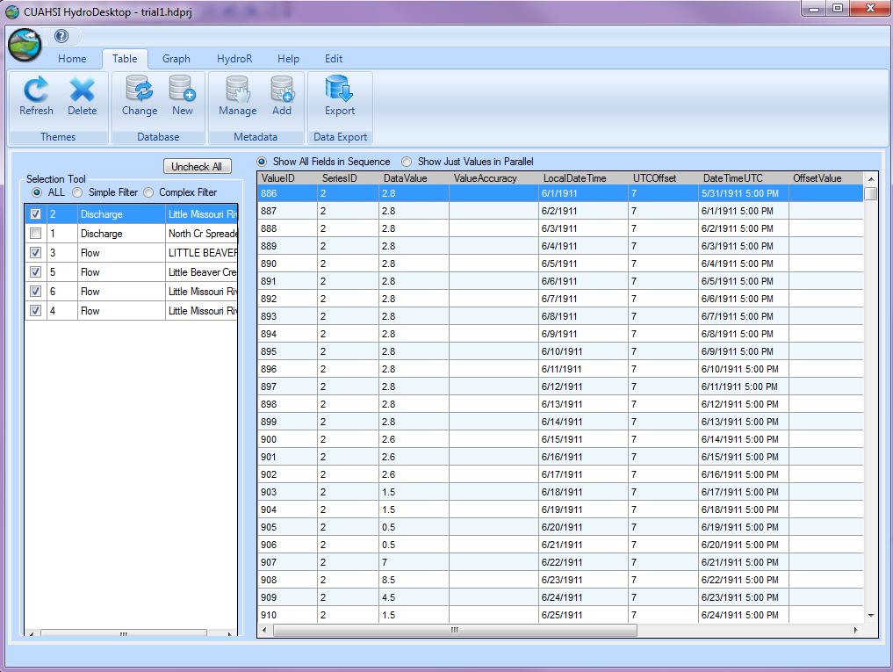
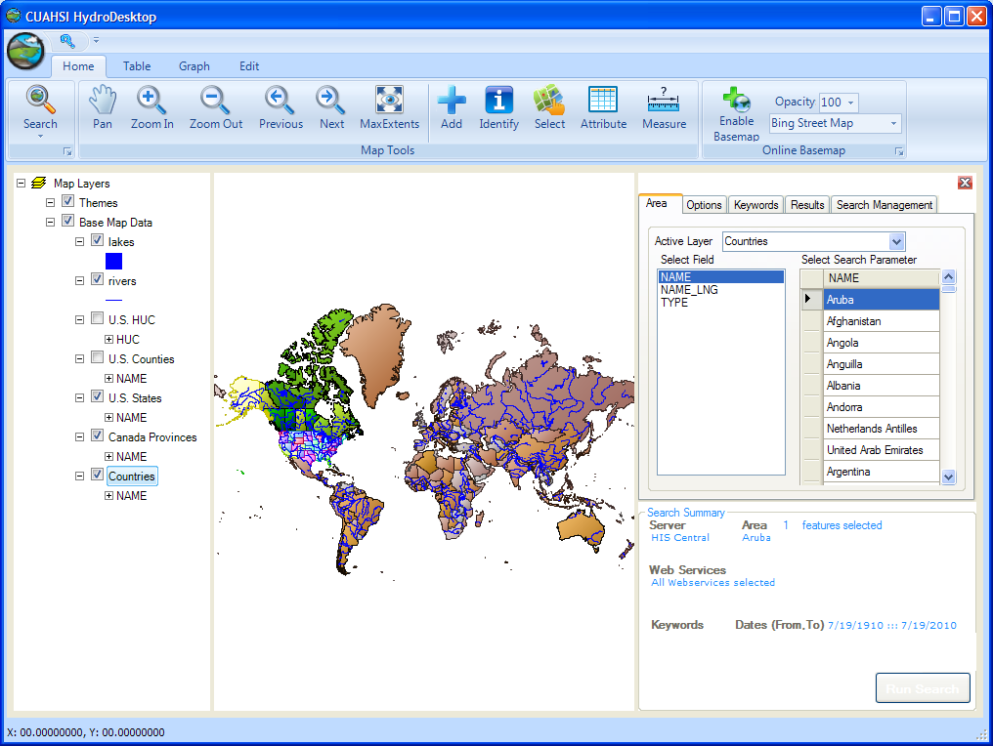
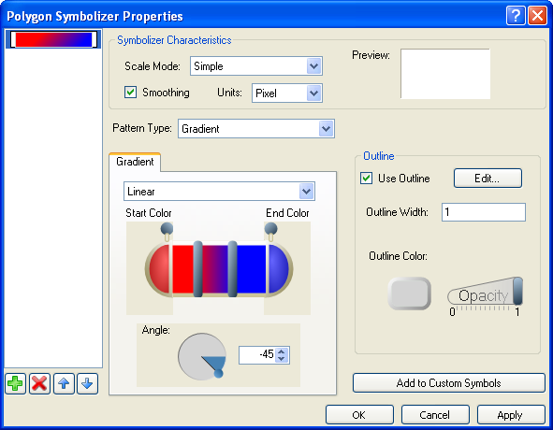
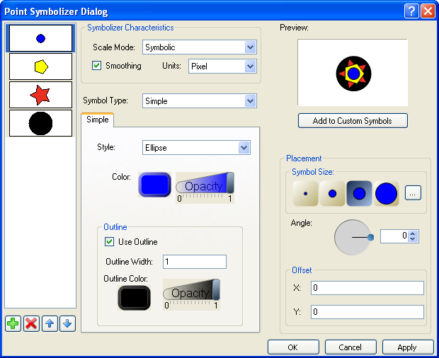
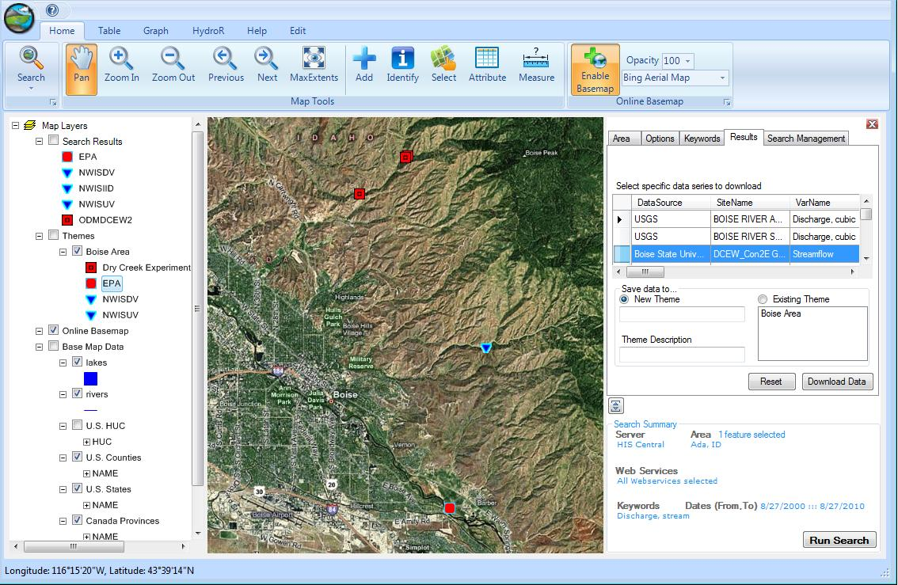
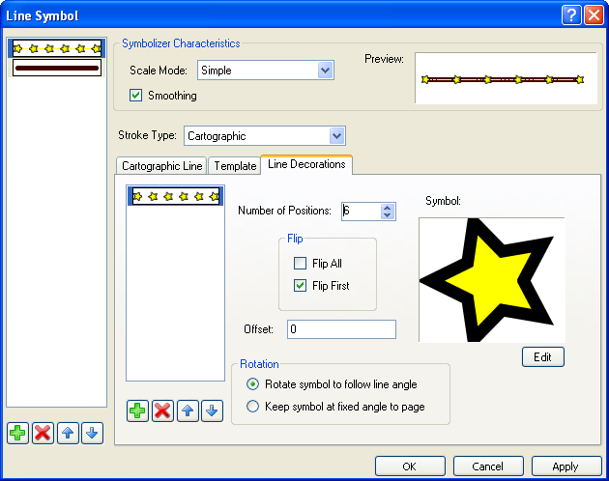
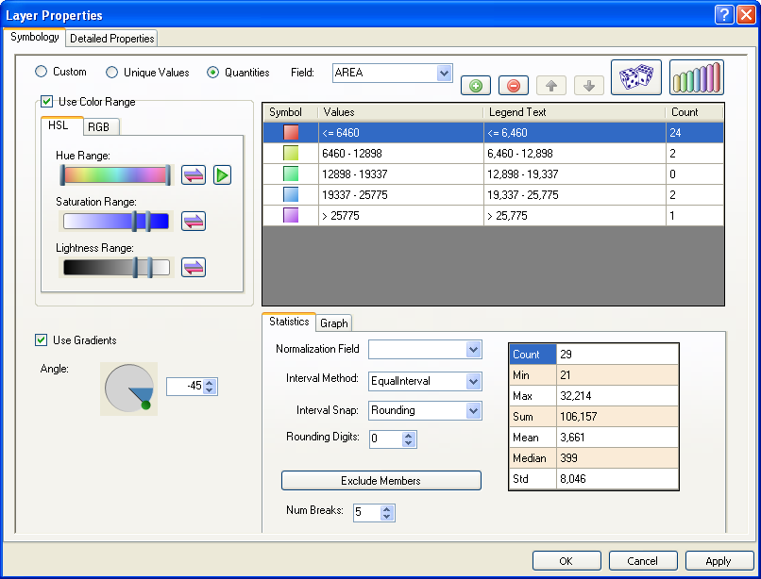
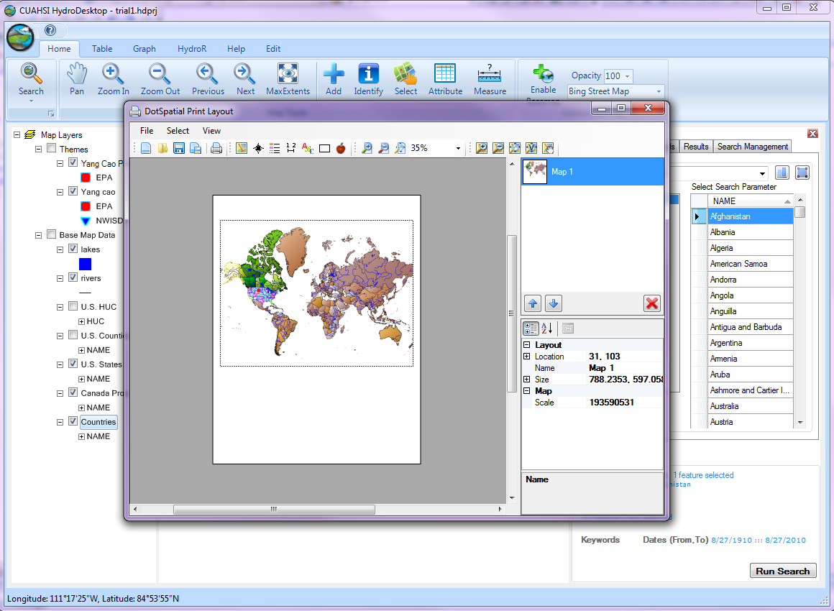
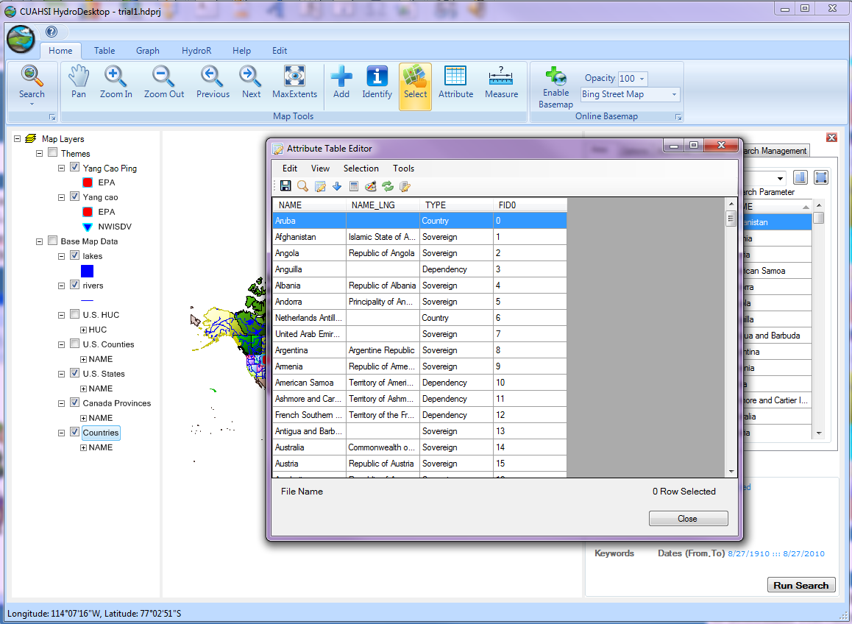
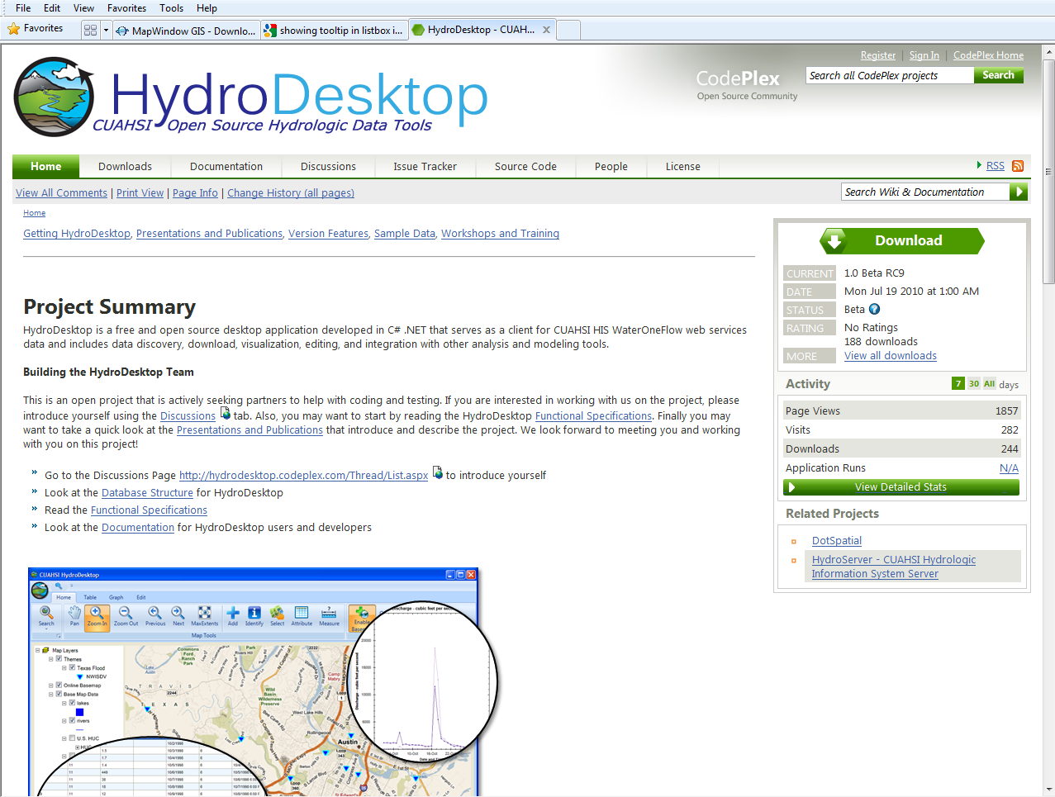
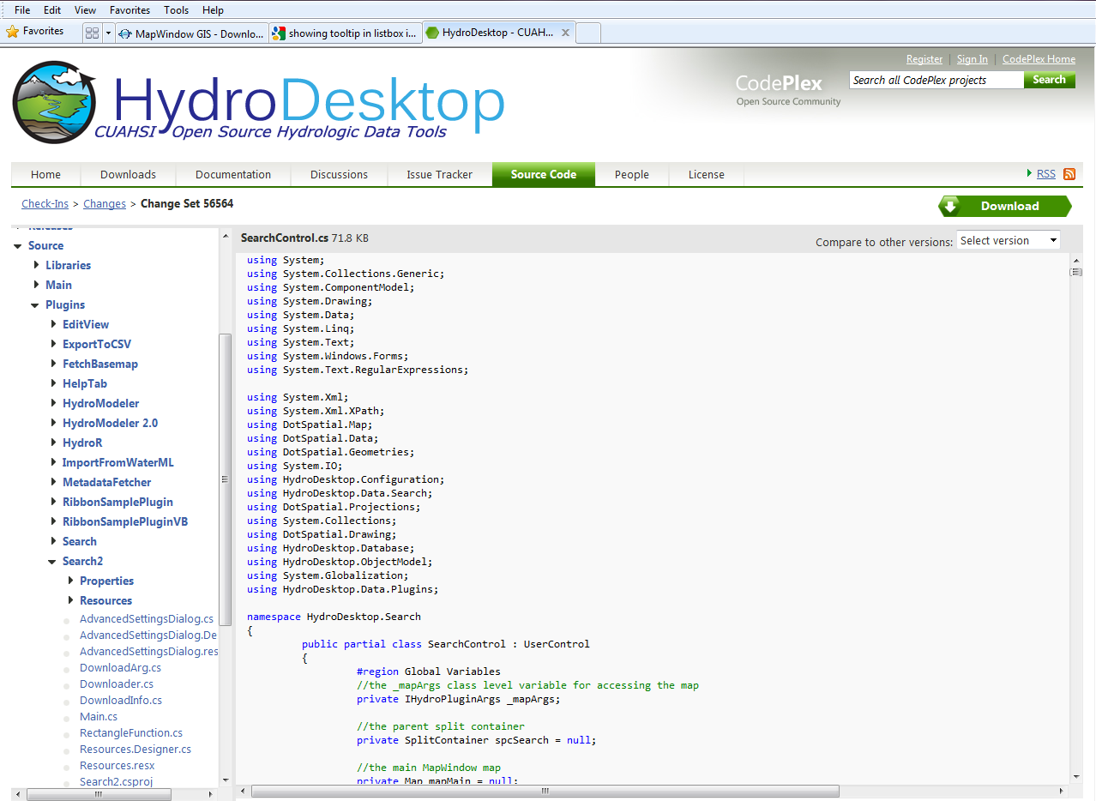
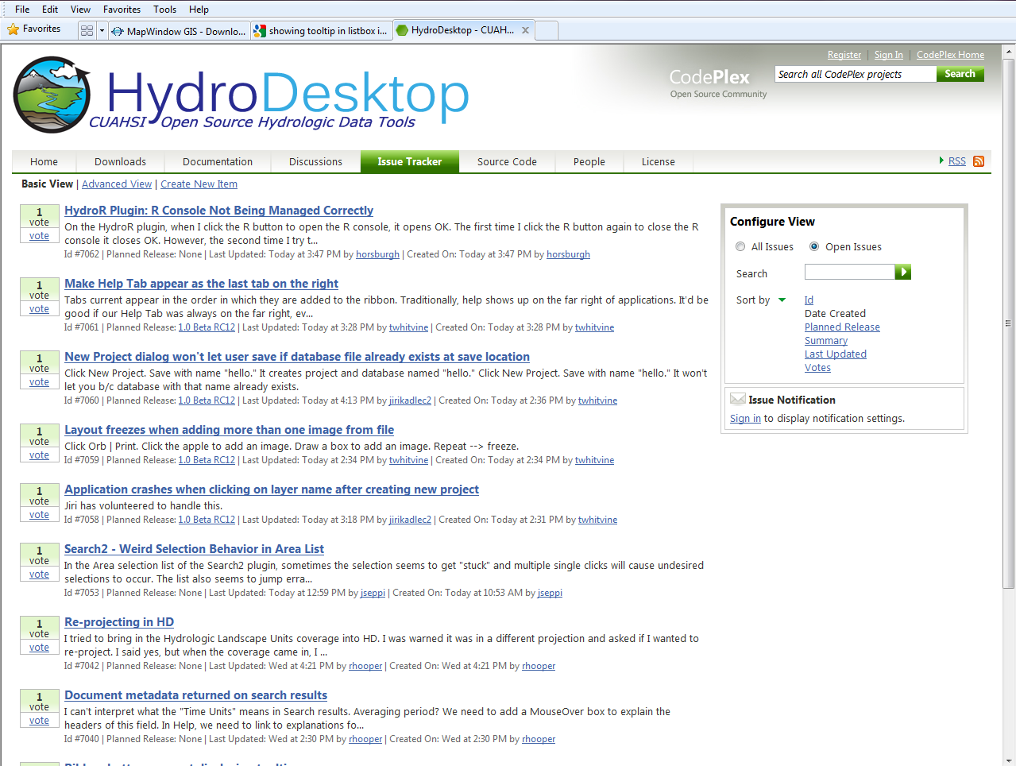
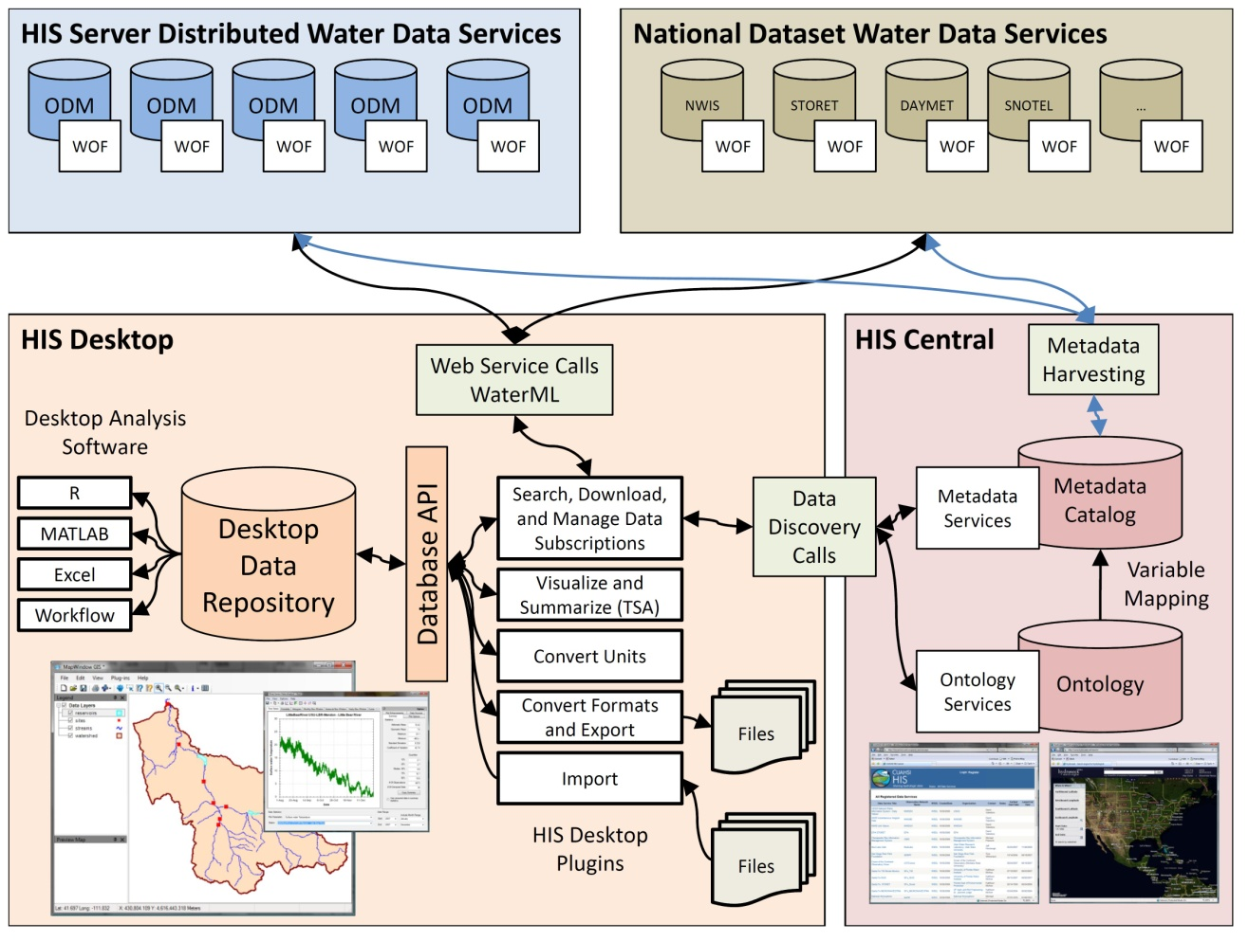
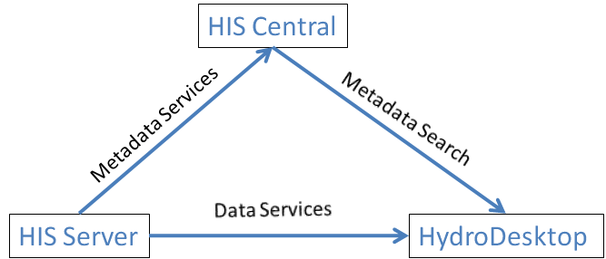
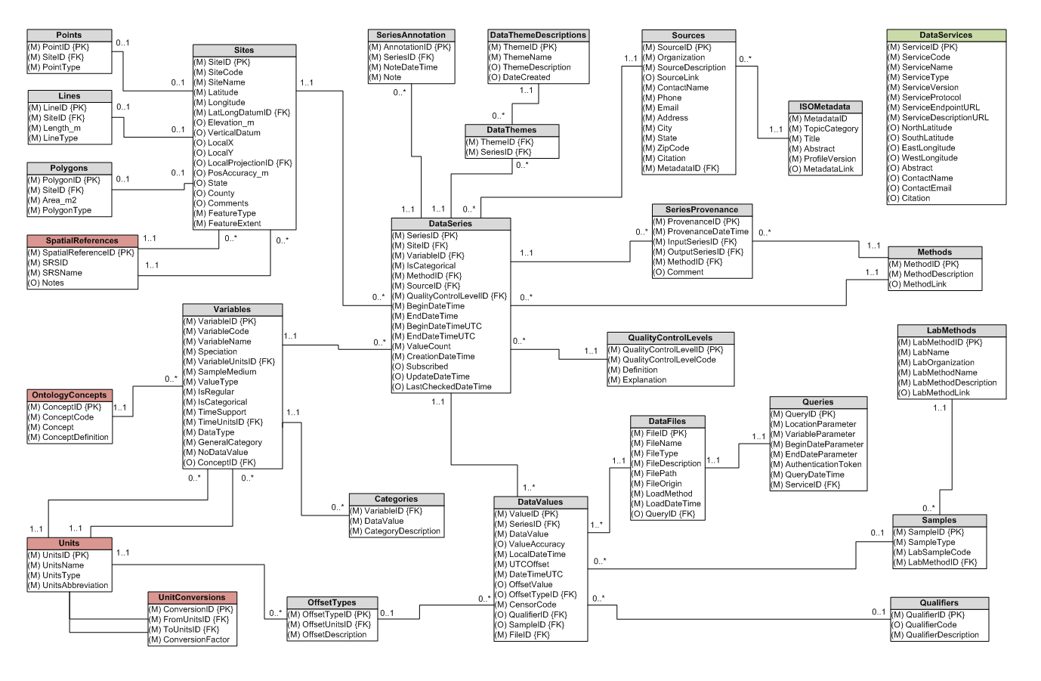
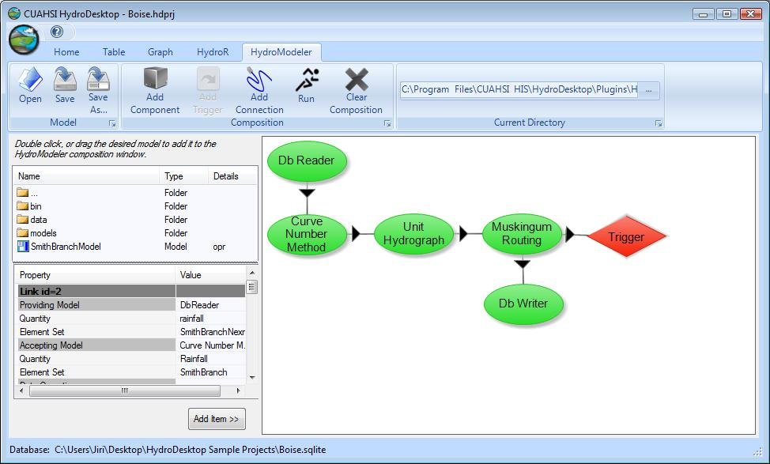
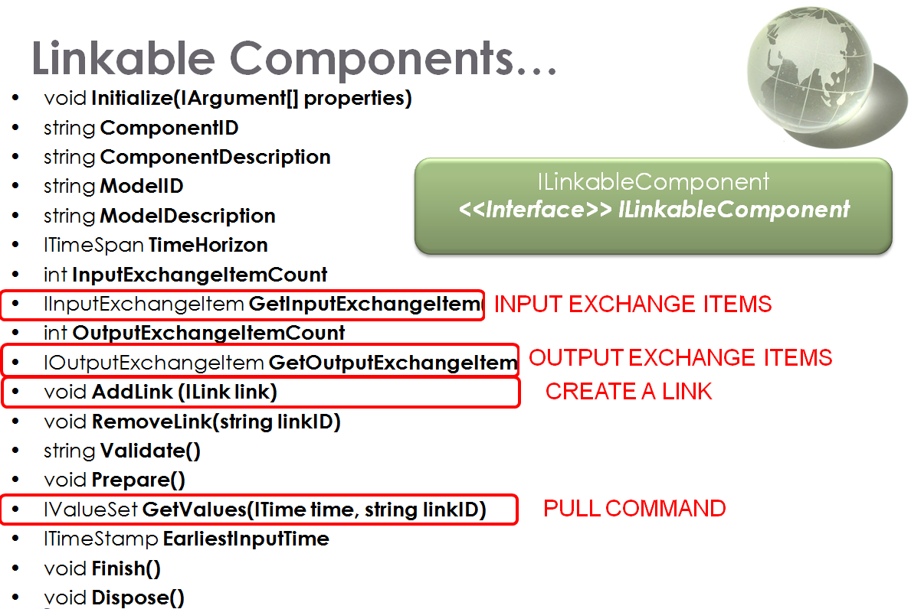
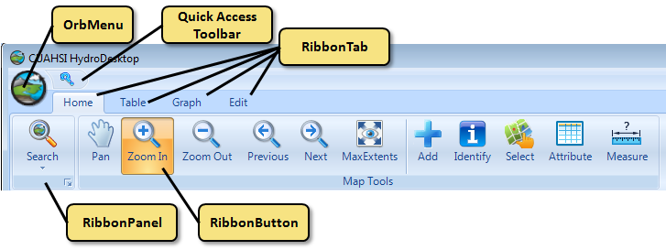
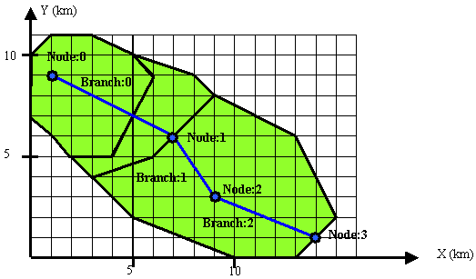
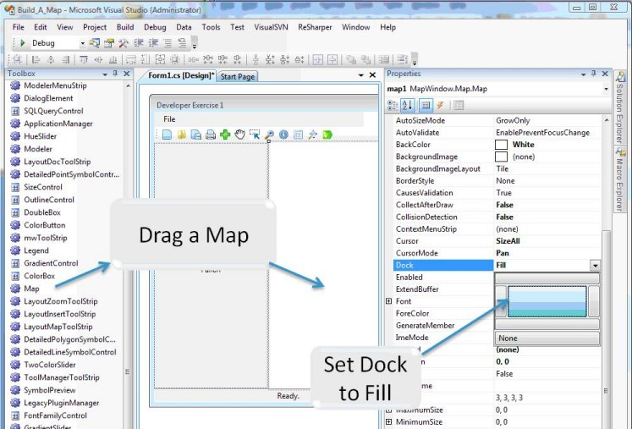
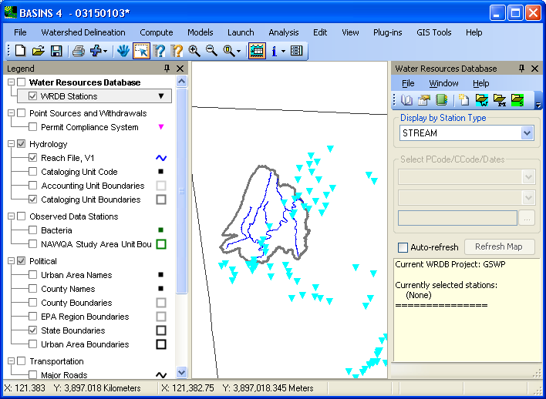
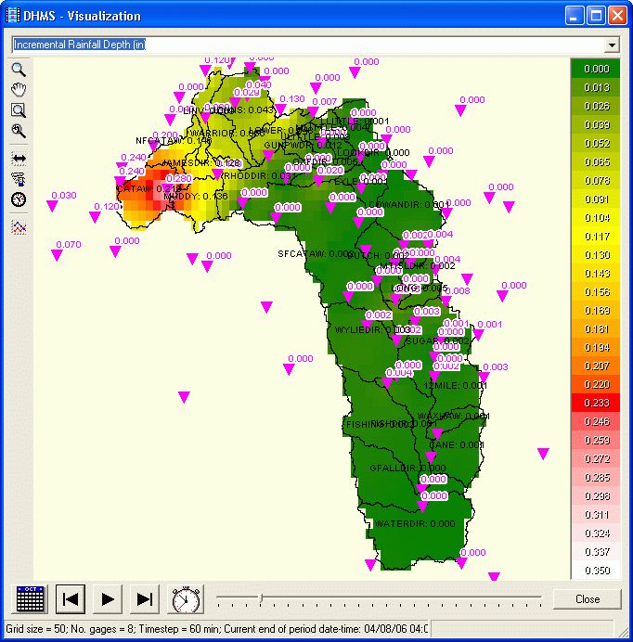
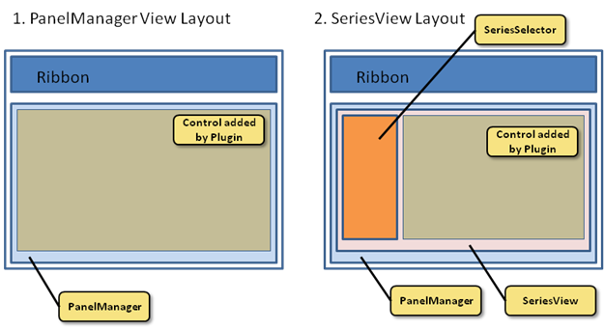
Daniel P. Ames, Jiří Kadlec, Yang Cao, Dinesh Grover
Contact: amesdani@isu.edu
Introducing the CUAHSI Hydrologic Information System Desktop Application (HydroDesktop) and Open Development Community
ABSTRACT
DATA SEARCH AND DISCOVERY
PURPOSE OF HYDRODESKTOP
This poster describes a new cyber-infrastructure software tool and user community developed by Idaho State University and the Consortium of Universities for the Advancement of Hydrologic Sciences (CUAHSI) Hydrologic Information System (HIS) project called “HydroDesktop”. HydroDesktop is a local (i.e. not server-based) client side software tool that will run on multiple operating systems and provide a highly usable level of access to HIS services. The software provides many capabilities including data query, map-based visualization, data download, local data maintenance, editing, graphing, data export to selected model-specific data formats, linkage with integrated modeling systems such as OpenMI, and ultimately upload to HIS servers from the local desktop software. The software is still in the early stages of development with version 1.1 beta ready for download and testing.
HydroDesktop uses the methods from the HIS Central metadata catalog API to provide search capabilities across the catalog to determine relevant data sets for a specific user. HIS Central is a hydrologic data registry a hosted at the San Diego Supercomputer Center in San Diego, California. The data discovery API is a web services based system for identifying hydrologic and water quality data services based on the CUAHSI Water Data Services protocols. A series of data discovery forms have been developed to provide the user with a quick and easy, step by step means of establishing the type of data they are looking for and the source from which they wish to find it.
HydroDesktop is intended to address the problem of how to obtain, organize and manage hydrologic data on a user’s computer to support analysis and modeling. As designed and developed thus far, HydroDesktop is focused on facilitating the discovery and access of hydrologic data and, secondarily, providing support for data manipulation and synthesis. It also provides a visualization tool for HIS Server based data and a platform for the integration of HIS data.
HydroDesktop is being developed using the DotSpatial open source GIS (geographic information system) software development toolkit together with a number of existing open source spatial and temporal data analysis and visualization tools. In this way, the full software package meets the requirement of being completely open source and accessible for third party developers and researchers. The source code for HydroDesktop is maintained at http://hydrodesktop.codeplex.com which is based on a community open source software development portal maintained by Microsoft. Additionally, HydroDesktop’s design maintains the use of a plug-in architecture that allows for the extension of the program’s core functionality and encourages third party participation in the open development community.
COMMUNITY CODE DEVELOPMENT
GIS CAPABILITIES OF HYDRODESKTOP
Recognizing the value of community based code development as a means of ensuring end-user adoption, this project has adopted an “iterative” or “spiral” software development approach where 1) the general project requirements and hard boundary conditions are specified at the outset (this requirements document has been posted on the community portal); 2) an initial brief functionality requirements list is developed; 3) the initial limited system is produced primarily by the core funded developer team, but with voluntary external programmer support as it becomes available (ongoing development can be seen in the form of repository commit notifications at the web site; 4) testing and bug fixes by the developer team; 5) deployment of an installation package for end-users (a first installer is now available); 6) collection of bug notices and feature requests from end-users; 7) identification of specific bugs and features to be addressed in a new release; 8) addition of these features by the developer team, etc.
This development approach is the most common approach used by open source projects because of its flexible and dynamic nature. This model is well suited to a community project where it is difficult (and often not useful) to fully-specify the functionality set required for a software release. Rather it is desirable to maintain an open structure that can easily be extended through the development of third party plug-ins to support as-yet unknown functions and capabilities, as well as a clear policy on how code is moved into the core system, and how external developers are included in the developer team.
Community code development is managed through the open source software development portal, Codeplex, developed by Microsoft. The Codeplex site for HydroDesktop (www.HydroDesktop.org) includes a WIKI for documentation, a Subversion code repository management system, an issue tracking system, and a discussion forum system. All of these tools are publicly available for use on the web site by the community. The only site functions that require specialized access are associated with committing code to the repository. At present we have an international developer team of 34 individuals with code committing rights on the site.
The following figures show some of the key functional sections of the Codeplex HydroDesktop site.
Because it is built upon the open source DotSpatial GIS platform (www.MapWindow.org), HydroDesktop includes a number of native GIS capabilities including symbology, vector editing, raster and vector data manipulation, print layout generation, and geoprocessing. HydroDesktop supports vector and raster data in a large number of file formats supplied through the GDAL, OGR, and FDO libraries. Some of the GIS functions are represented in the following figures.
Ribbon
Map Layers
Map
Data Search
STRUCTURE AND DESIGN
HydroDesktop uses the methods from the HIS Central metadata catalog API to provide search capabilities across the catalog to determine relevant data sets for a specific user. HIS Central is a hydrologic data registry a hosted at the San Diego Supercomputer Center in San Diego, California. The data discovery API is a web services based system for identifying hydrologic and water quality data services based on the CUAHSI Water Data Services protocols. A series of data discovery forms have been developed to provide the user with a quick and easy, step by step means of establishing the type of data they are looking for and the source from which they wish to find it.
INTEGRATED HYDROLOGIC MODELING
The HydroDesktop plug-in interface supports 3rd party development of extensions and plug-ins that add functionality to the base system and build upon the GIS and hydrologic database underlying components and programmer tools. The HydroModeler is an advanced plug-in that extends the core functionality of HydroDesktop to include an integrated modeling environment. HydroModeler is an embedded version of the Open Modeling Interface (OpenMI) Association Technical Committee’s (OATC) Configuration Editor and allows users to manage OpenMI-based model coupling and execution. It is designed to maintain all of the original OATC Configuration Editor’s functionality. The plug-in is provided along with OpenMI components for reading and writing data to the HydroDesktop data repository. Some basic model components are also provided in an example composition discussed in the following section. The primary benefit of HydroModeler, however, is that by following industry standards, any OpenMI compliant model can be used within the HydroDesktop environment. For more information on the OpenMI standard and the OATC Configuration Editor, please visit http://www.openmi.org.
MAPWINDOW AND DOTSPATIAL GIS LIBRARIES
The archive, catalog, and search structure of the HIS (above). HydroDesktop Data Repository Database Schema(below).
The MapWindow GIS platform is an open source GIS software project that includes a desktop application and several component libraries for use in 3rd party software development. These libraries include DotSpatial Map, legend, symbology, table editor, and other components that can be assembled to create GIS enabled software in any .NET compatible development environment. MapWindow desktop application has approximately 6000 downloads per month and a global user base. The plug-in environment provided by DotSpatial is used as a basis for extending HydroDesktop.
HydroDesktop as a data client for the HIS (above) Application graphical layout structure (below)
Namespace | Source/Derived From | Status
DotSpatial.Data | Original Code + extension architecture for OGR and GDAL | Initial commit available with initial documentation
DotSpatial.Projections | Proj4/Proj4.NET | Initial commit available with initial documentation
DotSpatial.Desktop | MapWindow6 - There is extensive work here that needs to be broken out into appropriate namespaces. | Initial commit available with initial documentation
DotSpatial.Topology | Net Topology Suite | Initial commit available with initial documentation
HydroDesktop Project development is supported by the NSF EPSCoR Program and by the National Science Foundation under award number EPS-0814387

